Slide 1
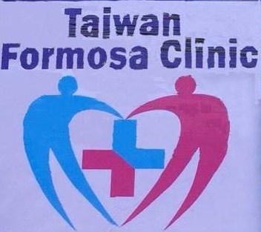

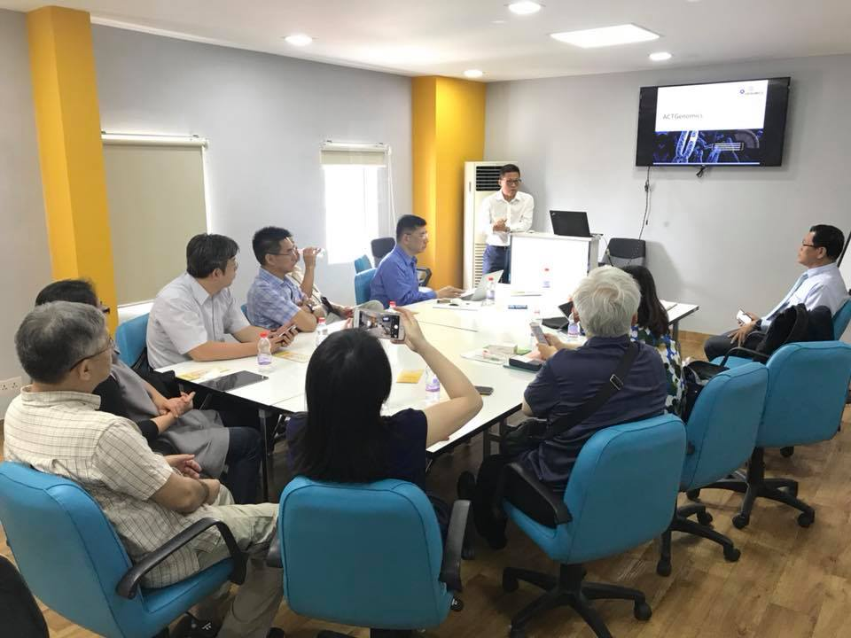
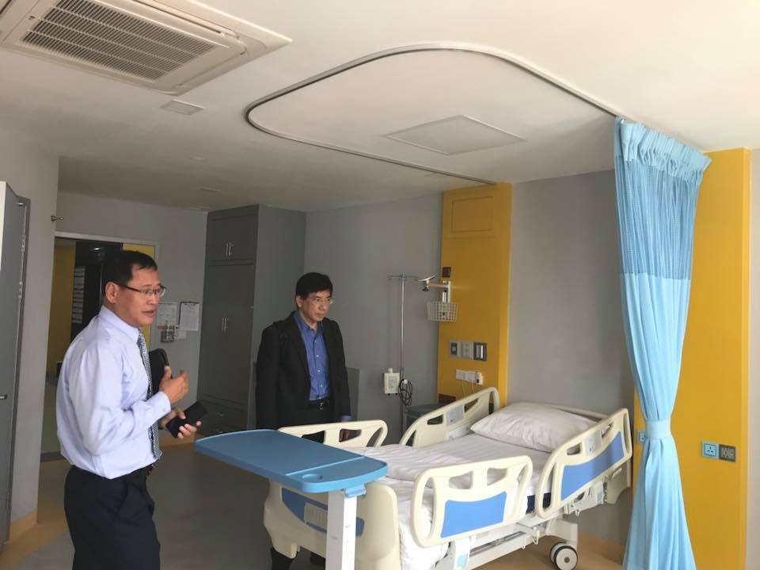
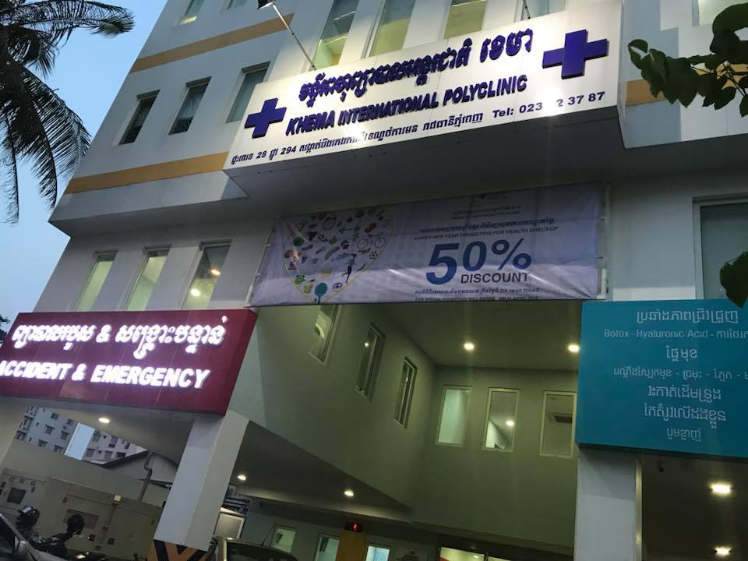
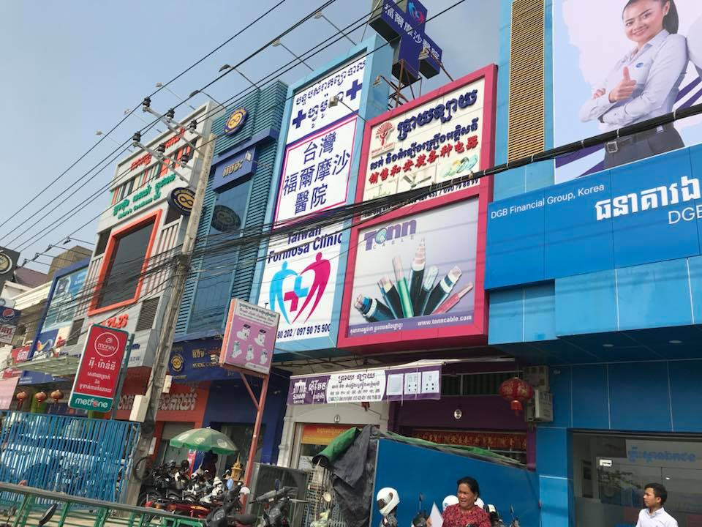
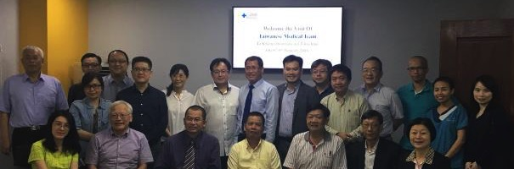
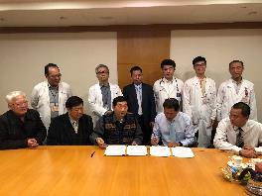
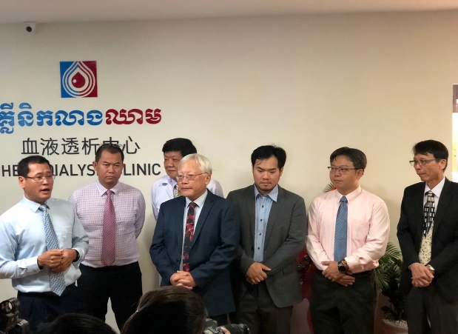
INTERNATIONAL COLLABORATION
Cambodia
Referral
collaboration
May 2018 Inauguration of Mandarin Clinic
October 2018 Smart Hemodialysis Center

Slide 2

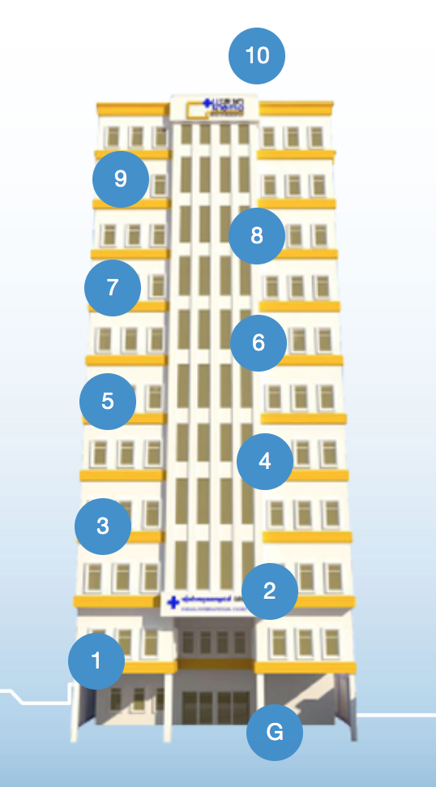
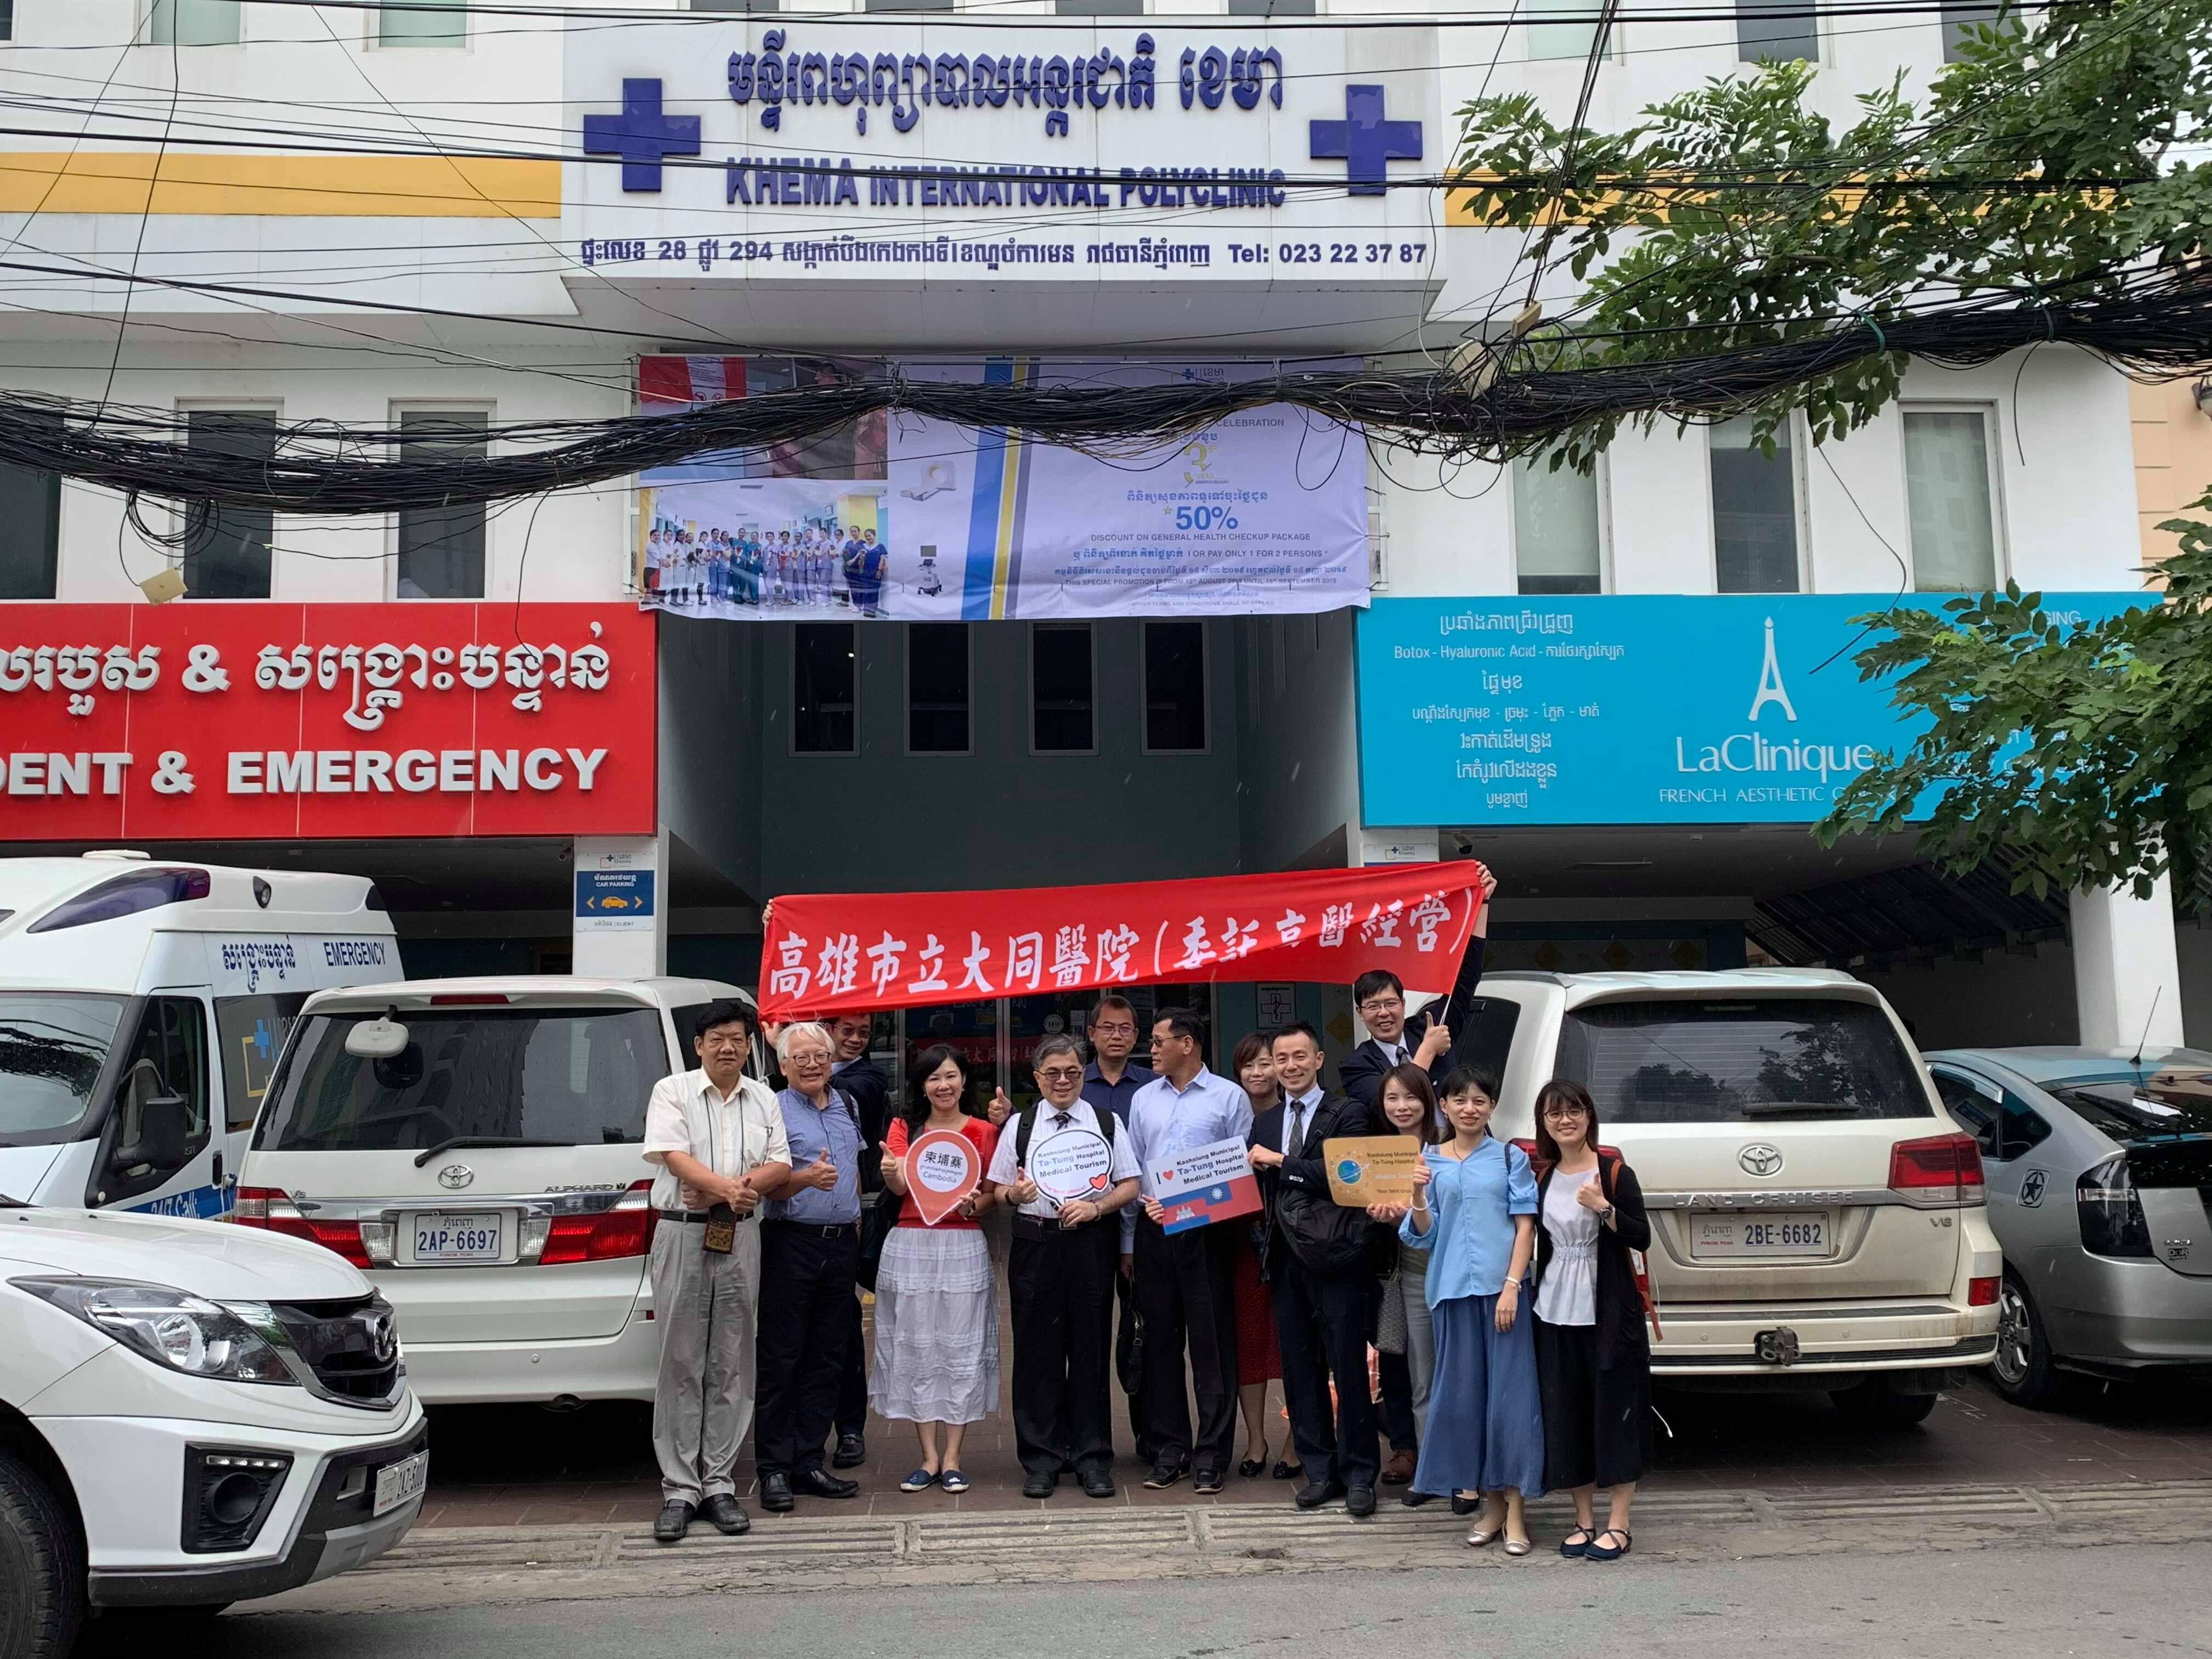

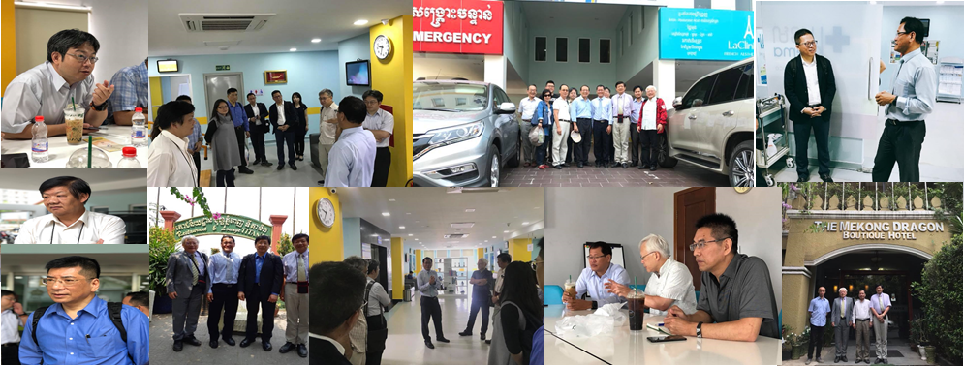
Khema international polyclinics
May 2018 Inauguration of Mandarin Clinic (2nd floor)
October 2018 Smart Hemodialysis Center

Slide 3
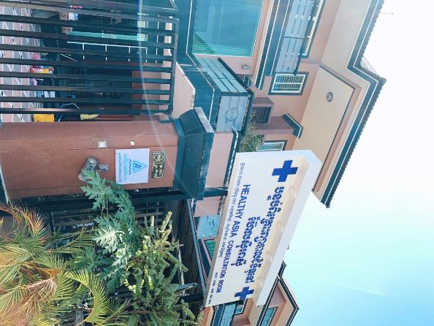
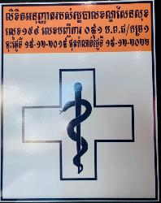
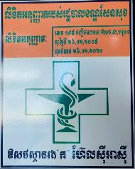
Head office in Phnom Penh
Academia Formosania Co. Ltd.

Slide 4
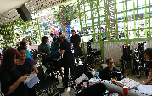

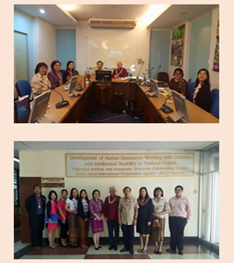
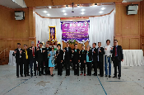
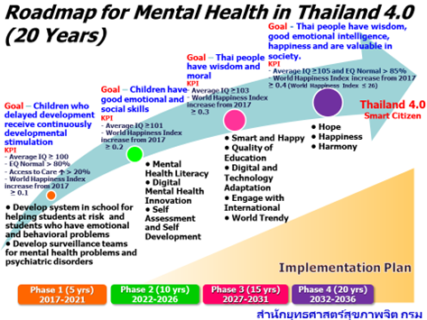

INTERNATIONAL COLLABORATION
THAILAND
連結滇緬邊境智慧社區小鎮/傳統醫藥發展
Integrating information technology in medical care and long term care model
Assisting Thailand 4.0 Industrial development plan
Co-assisting Burma and Laos for medical development
Transitional Smart Hospital
Workshop
Planning of Smart City

Slide 5
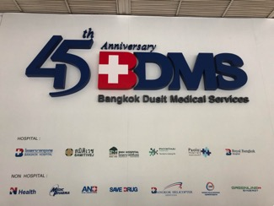
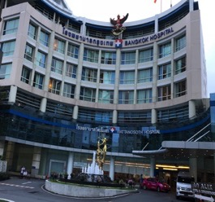

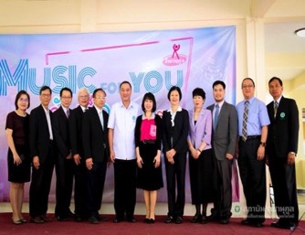
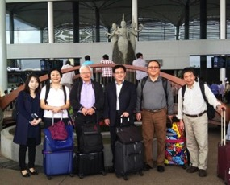
INTERNATIONAL COLLABORATION
THAILAND
Joint establishment between Thailand and Taiwan
Linking Royal Bangkok Hospital Group
Importing Chimei Medical Center’s gene counseling
Strengthen the medical network in emergency department of Royal Bangkok Hospital
Alliance with RSU, the biggest private university in Thailand
Thailand Director, Ministry of Health invites for further collaboration

Slide 6
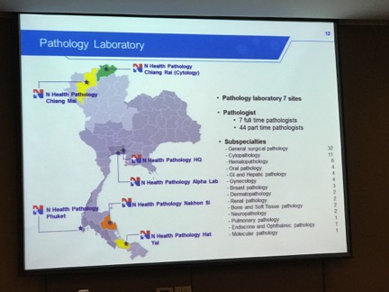
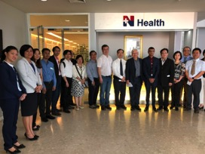
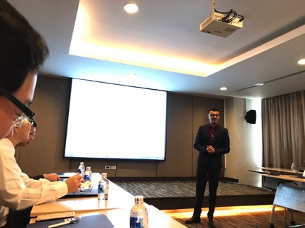
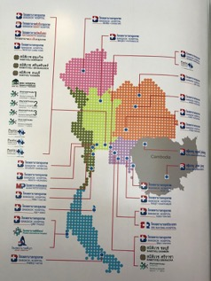
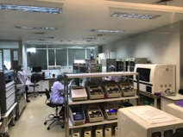
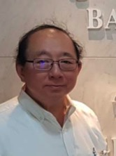
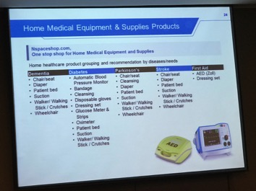
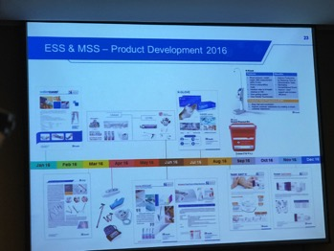
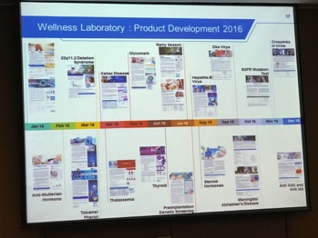
INTERNATIONAL COLLABORATION
THAILAND
Cooperation with N-Health, Thailand for the supplies in Southeast Asia

Slide 7
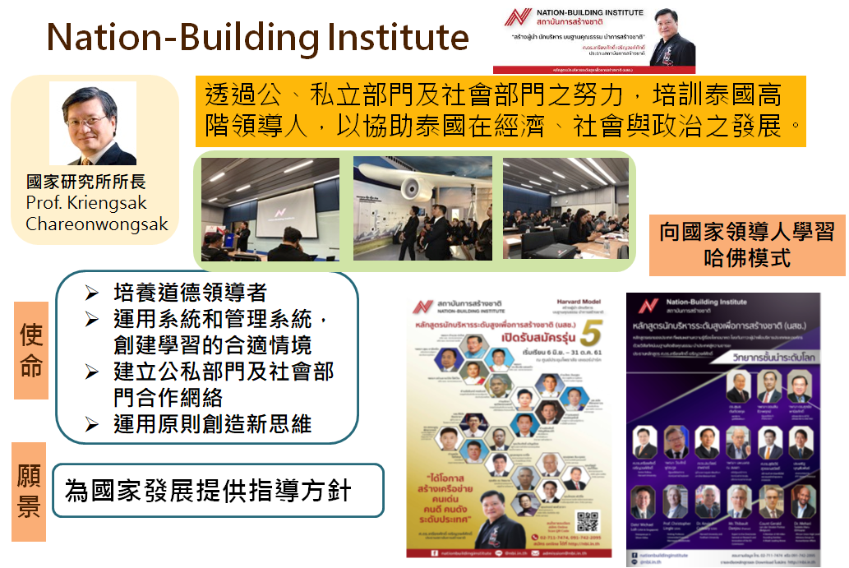

Slide 8
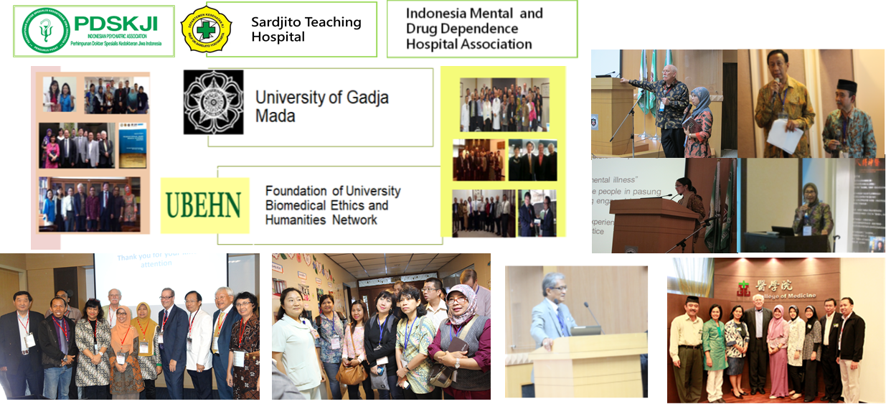
INTERNATIONAL COLLABORATION
Indonesia
Notes:
在印尼認識國務卿，基地是全國敎學醫院推廣、醫學教育改革和生命倫理學國家政策推廣中心的UGM大學，位於日惹。

Slide 9
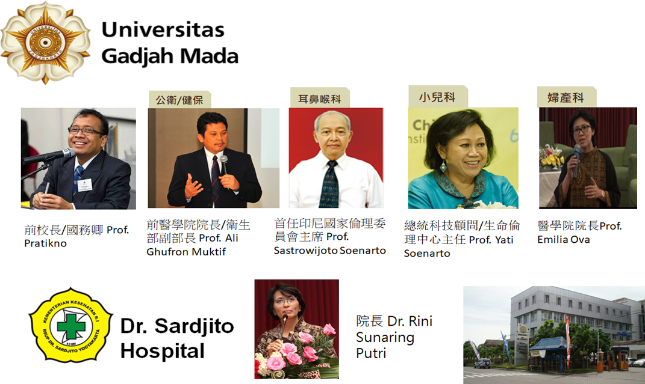
INTERNATIONAL COLLABORATION
Indonesia

Slide 10
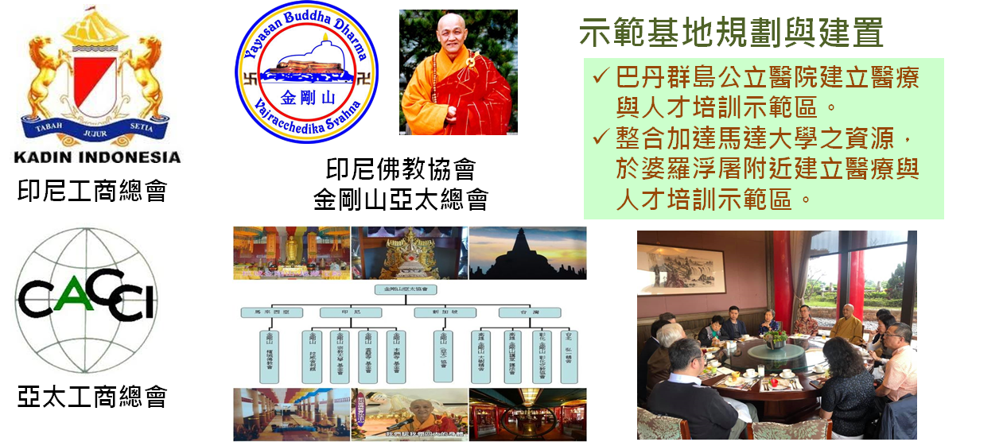
INTERNATIONAL COLLABORATION
Indonesia

Slide 11
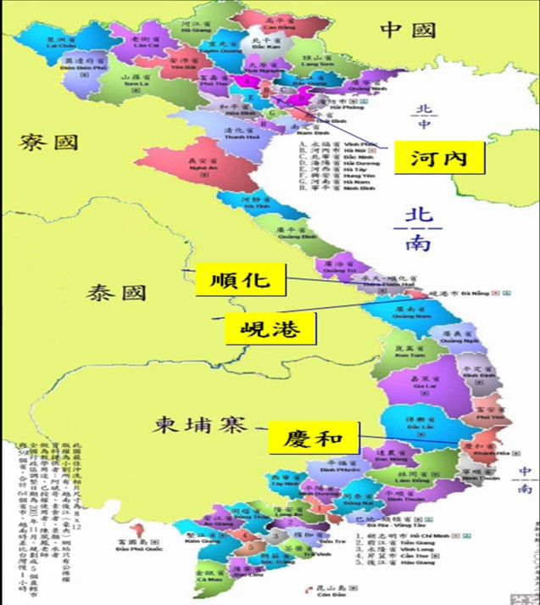
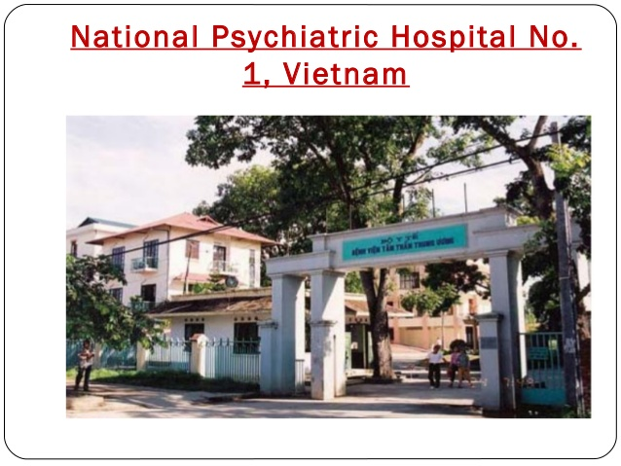
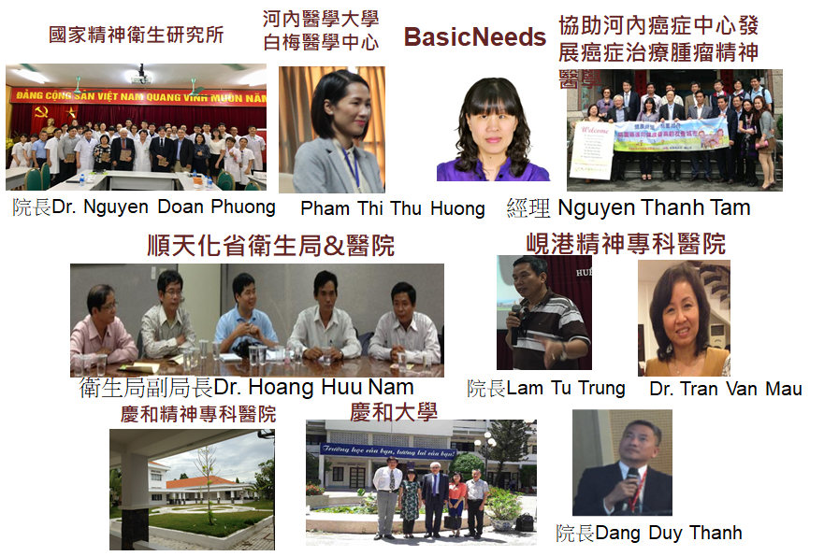

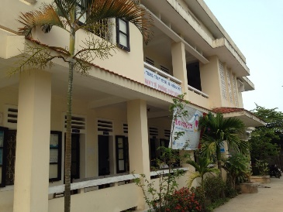
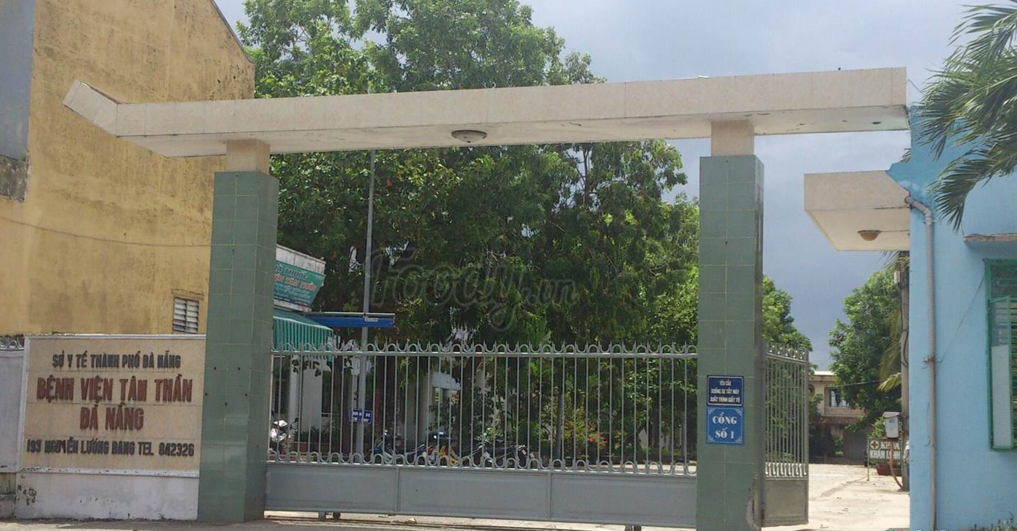
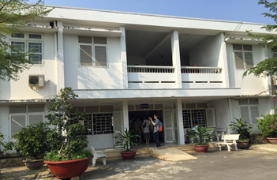

INTERNATIONAL COLLABORATION
Vietnam
Notes:
河內醫科大學、國家精神衛生院合作計畫 於河內建立完整由頂尖大學、科研機構到精神病院到奢區的精神醫療網

Slide 12
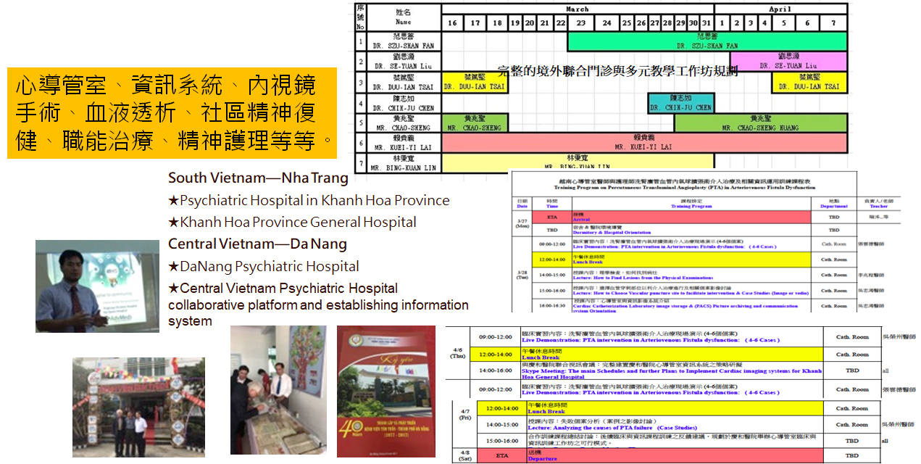
INTERNATIONAL COLLABORATION
Vietnam
Joint Outpatient Teaching
Outside Vietnam

Slide 13
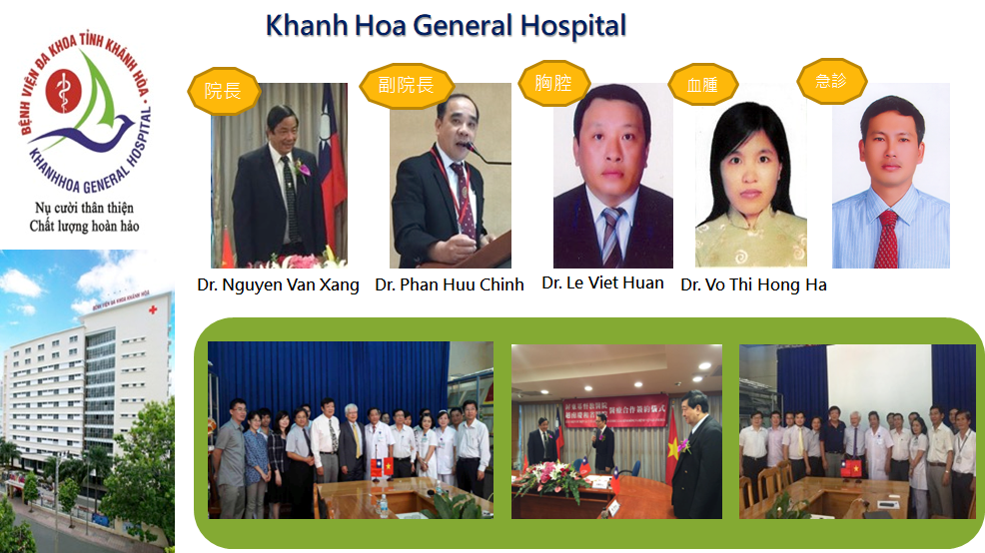
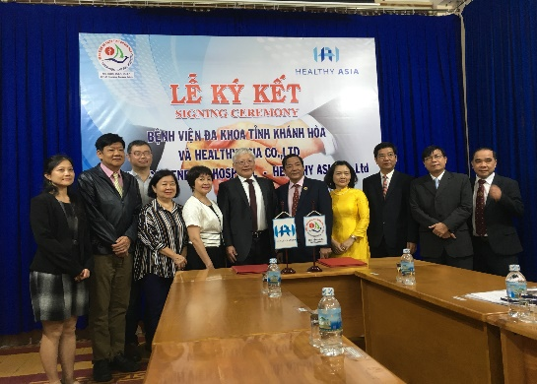
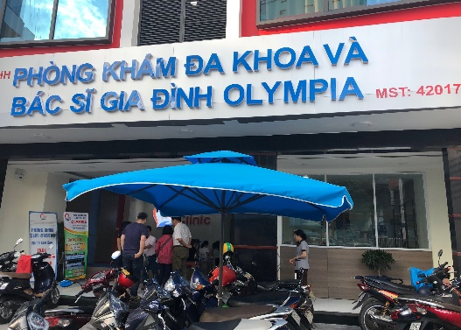
INTERNATIONAL COLLABORATION
Vietnam-KHANH HO GENERAL HOSPITAL

Slide 14
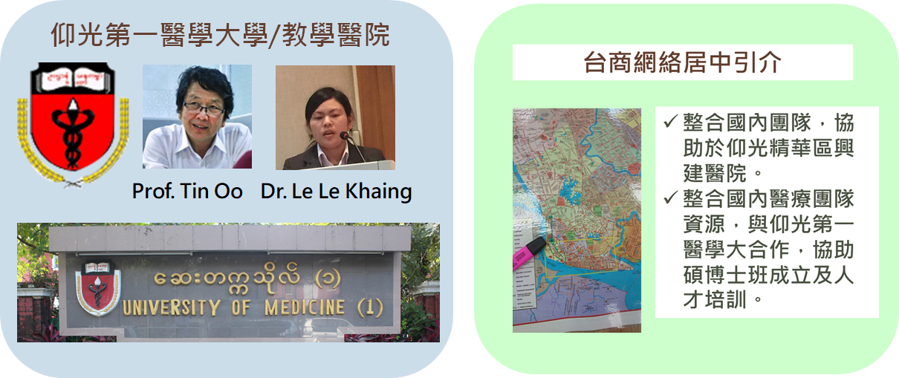
INTERNATIONAL COLLABORATION
BURMA

Slide 15

INTERNATIONAL COLLABORATION
Laos

Slide 16
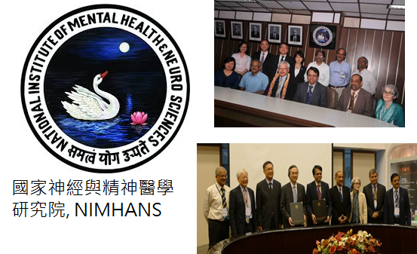
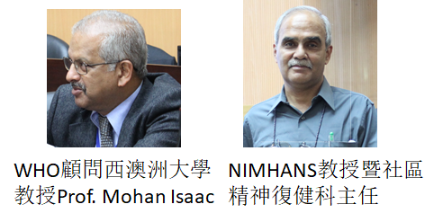
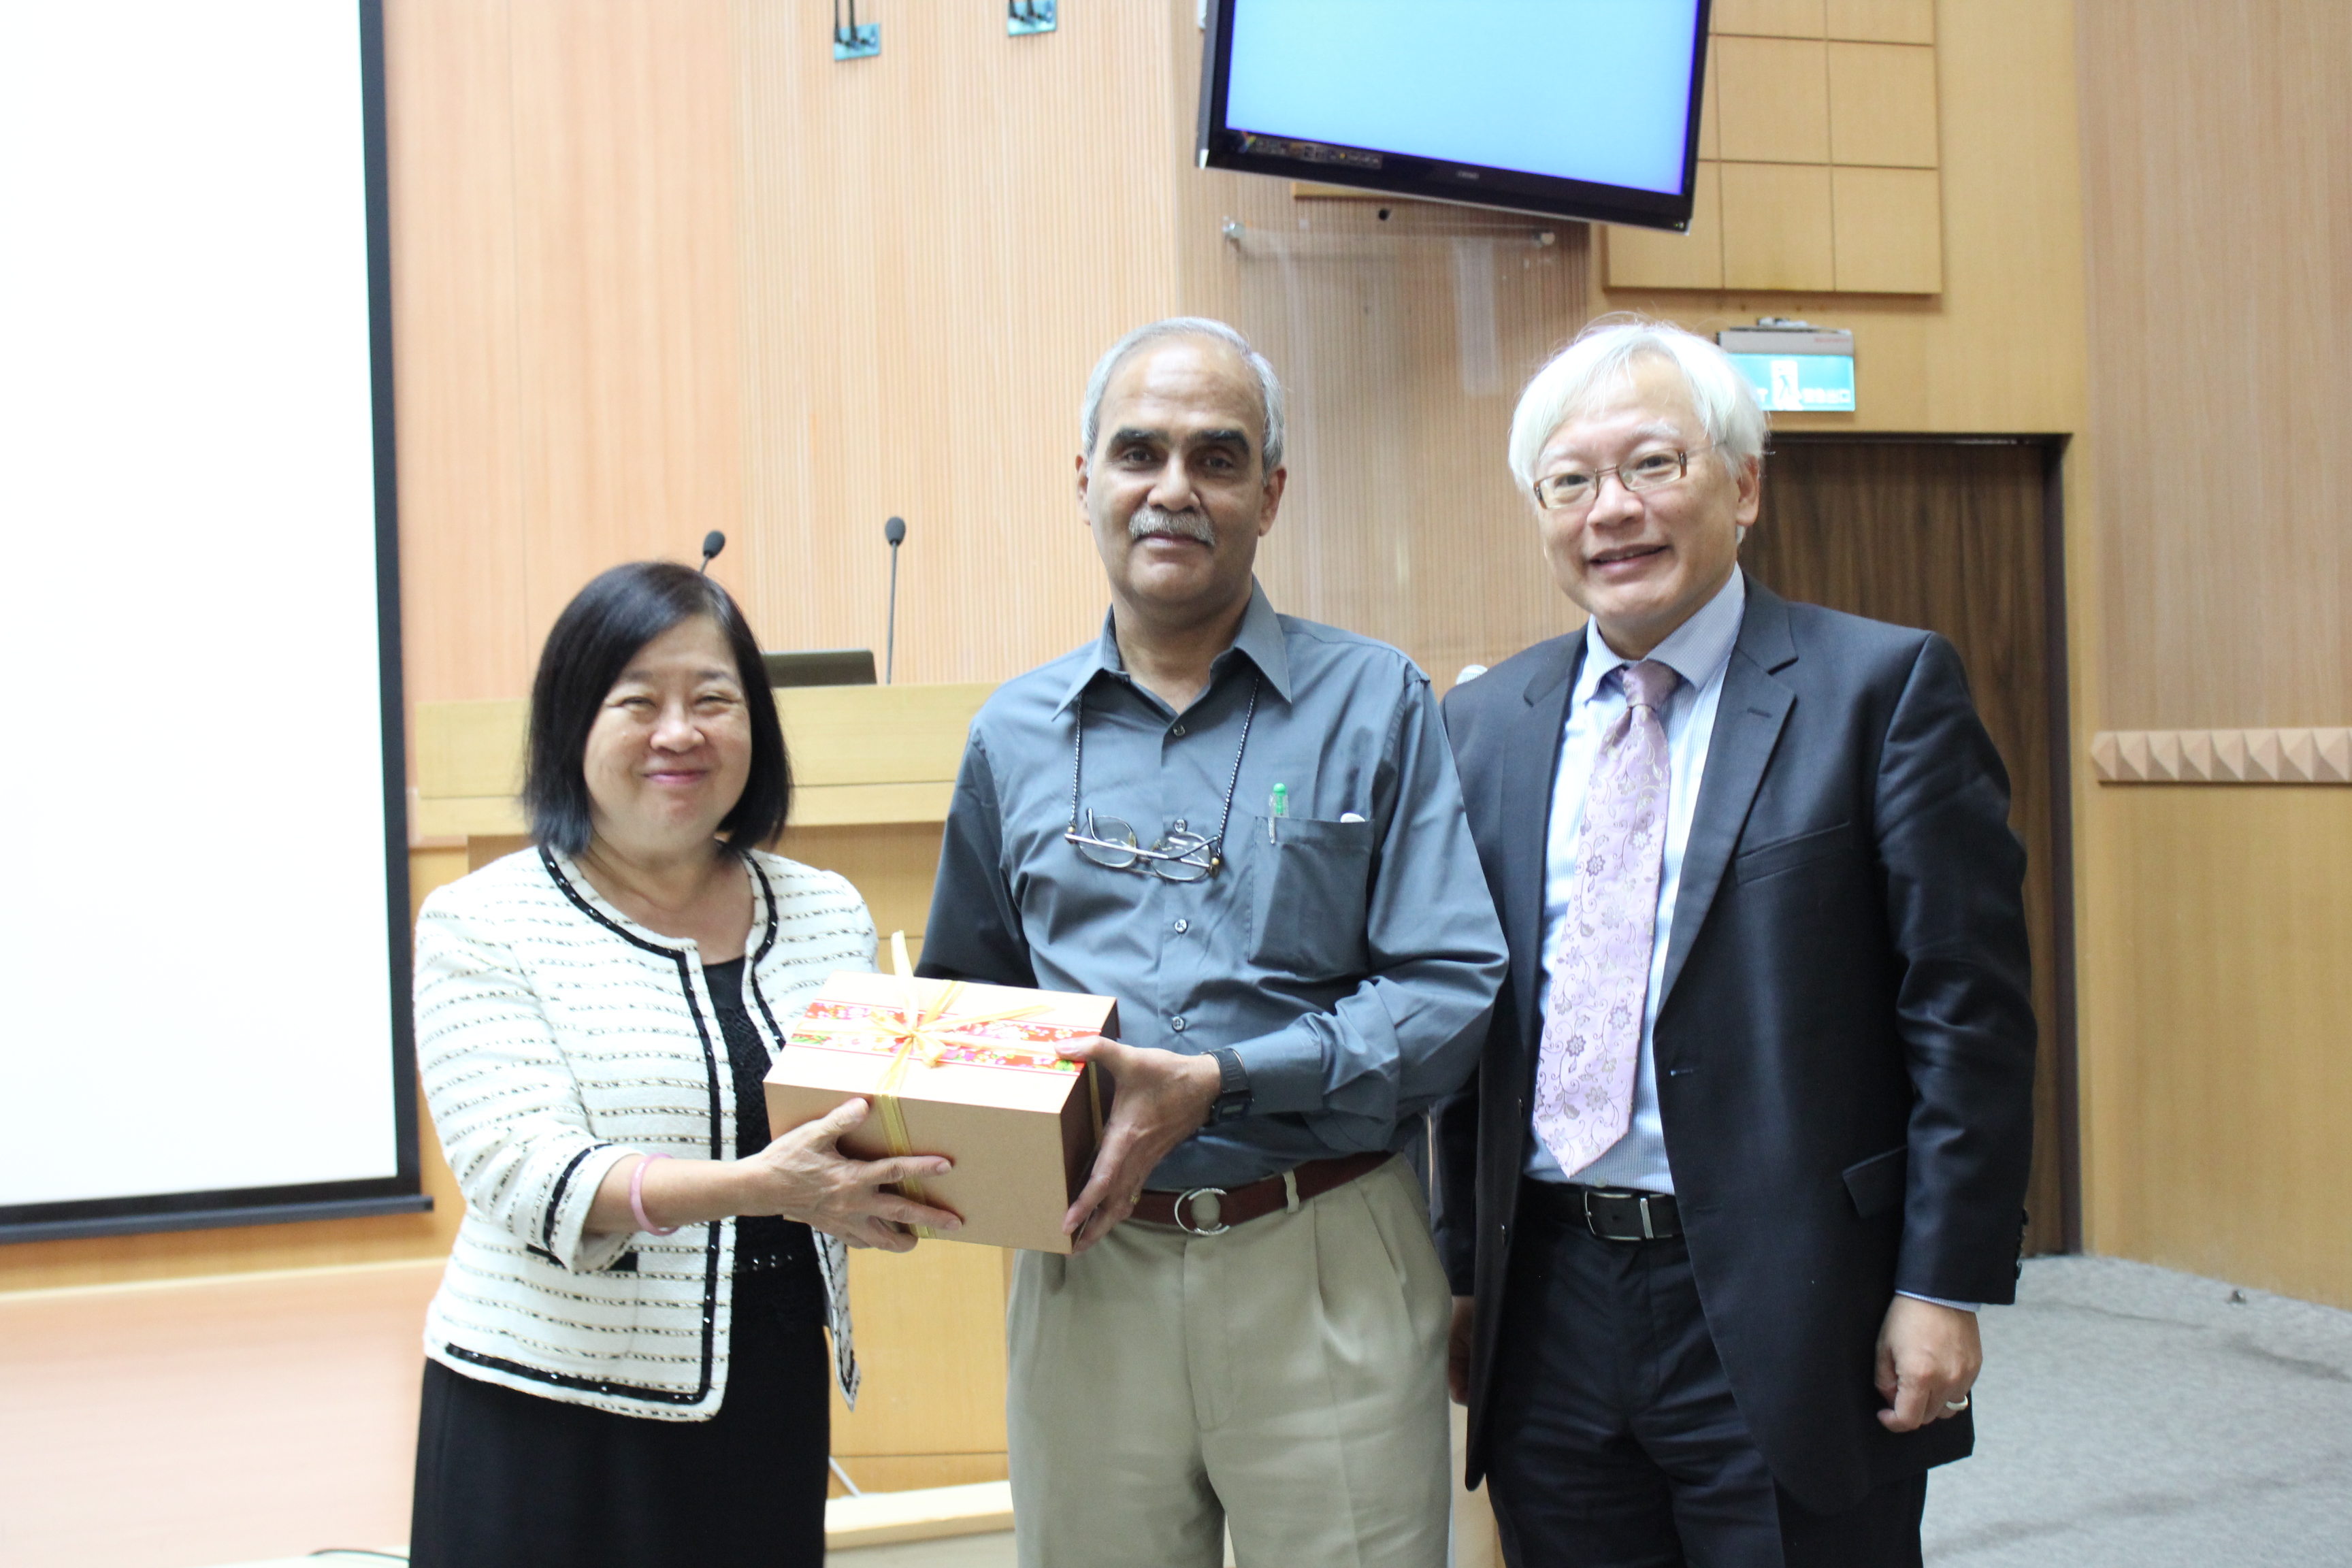
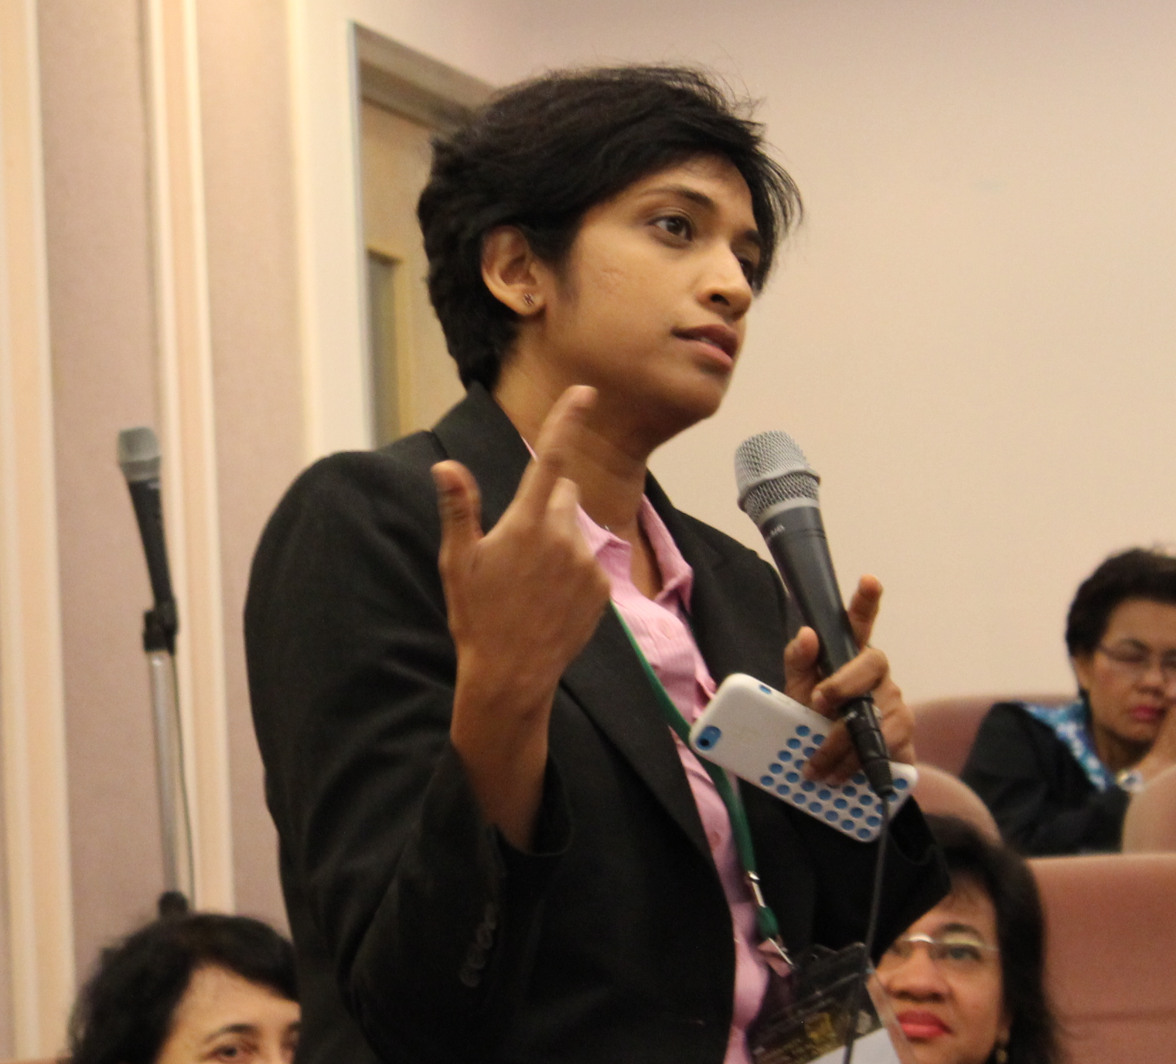
INTERNATIONAL COLLABORATION
India

Slide 17


INTERNATIONAL COLLABORATION
The Philippines

